Slide 1
ANCIENT INDIAN LITERATURE
SACRED LITERATURE

Slide 2
SACRED LITERATURES
RELIGIOUS & MYTHOLOGICAL LITERATURES
Hindu Literature
Buddhist Literature
Jain Literature

Slide 3
BRAHMANICAL LITERATURE
Conveys religious beliefs & practices of Brahmins
Provides information about the northern & north-western parts of India during 2nd and 1st
millennium B.C.
Consists of:
Vedas
Epics
Puranas
Vedangas
Dharmasutras

Slide 4


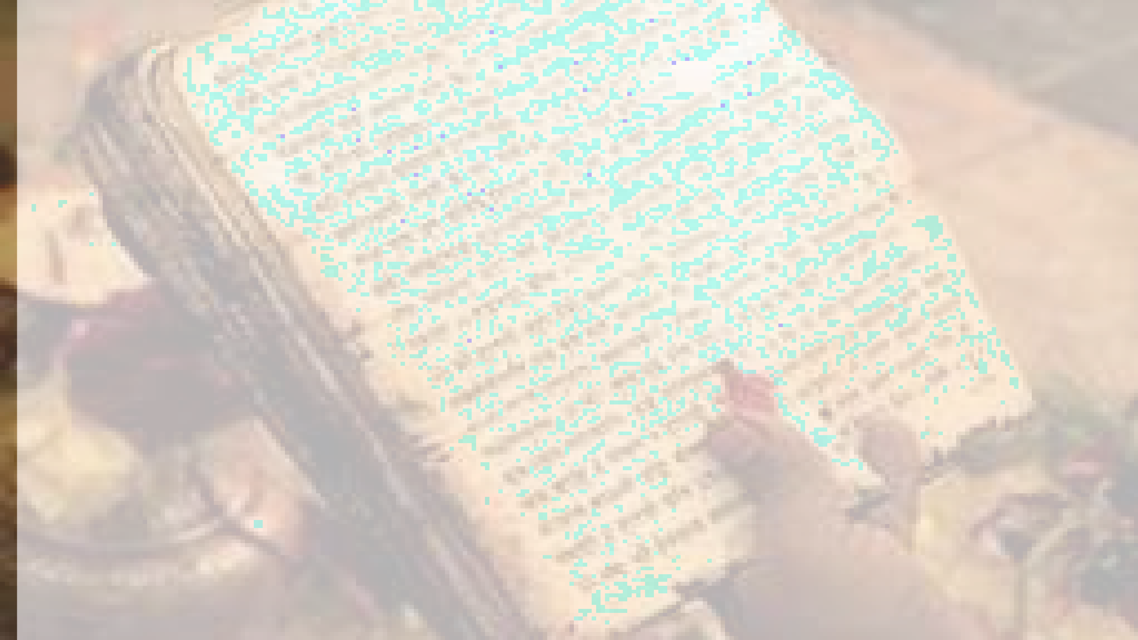
Religious texts
Shruti
Smriti
Vedas
Sutra
Ramayana
Mahabharata
Manusmriti
Puranas
Samhitas
Bhagavad Gita
(6th book)
Brahmanas
Aranyakas
Upanishads

Slide 5
VEDIC AGE (1500-600Bc)
EARLY VEDIC(1500-1000BC)
LATER VEDIC(1000-600BC)
The word veda is derived from WORD which means ‘to know’. The word veda means the sacred knowledge contain in the text known as Vedic texts.
Two categories of texts are including in the corpus of the vedic literature. These are Mantra and Brahmana.
The mantra category forms the core of the vedic texts and has four separate collections.
These are The Rigveda, The Samaveda, The Yajurveda, and The Atharvaveda.

Slide 6
The Vedas were initially handed down orally by generations of Brahmin families but it is estimated by historians that they were compiled around 1500 BC-1000 BC.
In the Hindu tradition, they are considered sacred because they are the divine revelations, which were determined by gods to guide humans eternally.
They also have larger implications on our lives as they treat the universe and its inhabitants as one big family and preach Vasudhaiva Kutumbakam.
These were mostly written by vedic seers and poets called the rishis who envisioned the cosmic mysteries and wrote them in the form of Sanskrit poetry
All the Vedas give prominence to yagna (sacrifice). The Brahmanas, the Upanishads and the Aranyakas accompany each Veda.

Slide 7
VEDAS
Contains “ETERNAL TRUTH”.
Realised by rishis and revealed to them by Gods.
Collection of hymns, prayers, sacrificial rituals, magic and nature poetry.
Rig Veda, a collection of 1028 hymns in praise of gods and creation.
Sama Veda, containing hymns, mostly from Rig Veda, to be chanted during sacrifices in which the juice of the Soma plant was offered.
Yajur Veda, dealing with details of rituals and sacrifices.
Atharva Veda, dealing with spells, magic and charms.

Slide 8
RIGVEDA(LATER VEDIC)
Rigveda is a collection of 1,028 hymns divided into 10 mandalas and called as the ‘ Book of Prayers ‘ . They are the earliest compositions and hence depict the life of the early vedic people in india.
In 1st Mandal, name of those God and Goddesses are given who developed in later vedic age. Therefore, it s the newest one.
9th Mandal was called as the SOM MANDAL which contains 114 hymns all dedicated to Som Dev.
GAYATRI MANTRA existed in Rig veda
Persons who speaks hymns of Rig Veda is termed as HOTRI

Slide 9
RIGVEDA
The entire Rig vedic hymns are dedicated to several deities, in particular to their chief deity, Indra.
Aryans personified the natural forces like Sun, Moon , Rivers and referred them as living beings.
INDRA was called as PURANDAR which means destroyer of forts . So , he was the most important divinity in Rig veda.
Indra was the leader of Aryans Who destroyed forts of Harappa. He was considered to be God of Rain.
AGNI was given 2nd position. Fire played an important role as it was used for cooking, burning forests etc.
VARUNA – water
SOMA – God of Plants
The other prominent Gods mentioned in the Rig Veda are, Rudra (God of wind/storm), Aditya (a form of Sun God), Vayu (God of air) and the Ashwini twins. There are several hymns dedicated to female Goddesses too; like Usha (Goddess of dawn), Prithvi (Goddess of earth) and Vak (the Goddess of speech)

Slide 10
SAMVEDA
It is known as the ‘Book of Music ‘.
Prayers converted into music/ rhymes in this book.
It is the first music book of the world and contained rythms and nodes converted from prayers.
Person who speaks hymns of Samveda is called UDGATA.
Sama Veda has been named after ‘Saman’ (melody) and it concentrates on melody or songs. While the entire text has 1875 hymns, historians argue that 75 are original and the rest have been taken from the Sakala branch of the Rig Veda. It consists of hymns, detached verses and 16,000 raga (musical notes) and raginis. It is because of the lyrical nature of the text that it has also been called the ‘book of chants’. It also shows us how Indian music has developed in the Vedic period.

Slide 11
YAJURVEDA
It describes different shapes and angles of fire pits related to different yagnas.
Person who speaks hymns of Yajurveda is called ADHVARYU.
It defines sitting arrangement between priests and men. Therefore called as ‘ Book of Geometry’.
Sama Veda has been named after ‘Saman’ (melody) and it concentrates on melody or songs. While the entire text has 1875 hymns, historians argue that 75 are original and the rest have been taken from the Sakala branch of the Rig Veda. It consists of hymns, detached verses and 16,000 raga (musical notes) and raginis. It is because of the lyrical nature of the text that it has also been called the ‘book of chants’. It also shows us how Indian music has developed in the Vedic period.

Slide 12
ATHARVA VEDA
This book is known as 'Basket of Superstitions’.
A person who chants hymns of Atharva veda is called 'BRAHMAN’.
Aryans who came from central asia were realistic while non- aryans were superstitious people. But Aryans also got influenced by the non- Aryans and became superstitious.
Several other books were written after the vedas . Some of them are the commentaries on the Vedas while the other explained the rituals of Vedas and yet others are work of philosophy of religion. They are called Brahamanas , Aranyaks , Upanishads and Sutras.

Slide 13
ATHARVA VEDA
This Veda is also known as Brahma Veda and has been attributed to two rishis called Atharvah and Angira, respectively. Because of its association with the two rishis, in the olden times it was also called Atharvangirasa.
While it is mostly concerned with peace and prosperity of the human society and covers all aspects of a man’s daily life, it specifically focuses on treatment of several ailments.
The book is known to prescribe treatment for almost 99 diseases. There are two major recensions (sakhas) of the text called the Paippalada and Saunakiya. Most of the text deals with healing and black and white magic; speculation on the changes in the universe; and even touches upon issues of the everyday problems in a householder’s life.

Slide 14
Parts of Vedas
Samhitas Brahmanas Aryankas Upanishads
Samhitas are the core collection of hymns, prayers and spells of the Vedas. They are often
mistakenly referred to as the Vedas.
Brahmanas are explanations of the Samhitas and give details of rituals and outcomes. Aryankas (forest books) give philosophical interpretations of the rituals.
Upanishads, also called Vedantas, deal mostly with the philosophy of atman (soul) and brahman
(ultimate spiritual reality of the universe).

Slide 15
THE UPANISHADS
The Upanishads are some of the sacred books of the Hindu people. The Upanishads are part of a large collection of sacred books of Hindu people, called the Vedas.
They are placed at the end of the Vedas and they primarily deal with knowledge or wisdom. Because they deal with knowledge portion of the Vedas, they are called Jnana-Kanda (Jnana means knowledge).
Also because they come at the end portion of the Vedas they are often called texts of Vedanta .
Many scholars believe that originally Upanishads are rebellion against Vedas and it has added to Vedas by its unique spiritual quest. Upanishad means "sit down with" master to learn about the Atman(soul).
The oldest, such as the Brhadaranyaka Upanishad and Chandogya Upanishad, may be as old as 8th century BC, while the youngest, depending on the specific Upanishad, may date to the medieval or early modern period. More than 300 text about Upanishad have been found but we have 108 Upanishad in written.

Slide 16
Upanishad
Interestingly, the term Upanishad or u (at), pa (foot), ni (down) and s(h)ad (to sit), i.e. to sit down near (the teacher), describes the text completely.
We have more than 200 known Upanishads and the teacher usually passed them down verbally to his students in the forest while they sat in front of him. This tradition was part of the guru-shishya parampara.
These are treatises written in Sanskrit and give an account of the Vedas in predominantly monastic and mystical terms. As they are generally the last part of the Vedas, they are also known as Vedanta or ‘end (anta) of the Veda’.

Slide 17
The Upanishads are said to have the ‘truth’ about human life and show the way towards human salvation or moksha.
They continue to talk about the abstract and philosophical problems faced by mankind, especially about the origin of this universe, supposed origin of the mankind, life and death cycle and the material and spiritual quests of man.
Out of the above-mentioned 200 Upanishads, a set of 108 Upanishads has been called the Muktika Canon. This is supposed to be an important canon as the number 108 is equivalent to the number of beads on a Hindu rosary or mala.
The teachings propounded in the Upanishads have been part of the founding rituals of Hinduism

Slide 18
Concept of UPANISHADS
Many of the upanishads are present in the form of a dialogue between a Guru (teacher) and Shishya(student).
It deals with three concepts:-
Jiva- the individual soul
Jagat – The universe or cosmos
Brahman- The supreme soul/God
They contain discussion about jiva, jagat and brahman And the relationship between the three.
The Upanishads form the Foundational texts of one of the Most popular schools of Vedic philosophy – vedanta darshana

Slide 19
ISHA UPANISHADS
It is the second shortest Mukhya(primary, principal) Upanishad With just 18 shlokas.
It gets It’s name from the starting of the first shloka- “isha Vasyam idam Sarvam....”
It deals with the concepts of Vidya and Avidya (knowledge and ignorance), the paths of Sannyasa and Karma (Renunciation and action) and The Nature of the Self.
It also contain the famous shloka – ‘Hiranmayena patrena satya-syapi-hitam mukham, tattvam pusanna-pavrnu satya –dharmaya drstave’. (Ishopanishad.15) which is traditionally chanted before The practice of surya namaskara.

Slide 20
Concept of Vidya and Avidya
The isha Upanishads Prescribes combining vidya and avidya (knowledge and actions)
It says that those who worship vidya alone Or avidya alone enter into darkness.
Vidya and avidya lead to different results , therefore he who knows this and combines both crosses Over death and attains immortality.

Slide 21
KENA UPANISHAD
The kena upanishad is also known as Talavakara upanishad
It starts with the shloka “ keneshitam patati......” And is therefore called kena upanishad.
It is present in the form of the dialogue Between a shisya and the guru , who are both unnamed.
It deals primarily with the nature of the self, the way to it’s realization And the result of Brahma- jnana (knowledge of Brahman)
Kena (Sanskrit: केन) literally means, depending on the object-subject context, "by what, by whom, when, how, why, from what cause".This root of Kena, in the sense of "by whom" or "from what cause", is found the inquisitive first verse of the Kena Upanishad as follows,
केनेषितं पतति प्रेषितं मनः केन प्राणः प्रथमः प्रैति युक्तः । केनेषितां वाचमिमां वदन्ति चक्षुः श्रोत्रं क उ देवो युनक्ति ॥ १ ॥
Sent by whom, flies out thither the mind? Harnessed by whom, roves thither the first breath? Who sends out the speech which we speak? Who is the Deva (deity, god) that harnesses the ears and eyes?

Slide 22
The Kena Upanishad opens by questioning the nature of man, the origins, the essence and the relationship of him with knowledge and sensory perception. It then asserts that knowledge is of two types - empirical and conceptual.
Empirical knowledge can be taught, described and discussed. Conceptual knowledge cannot, states Kena Upanishad. Pure, abstract concepts are learnt and realized instead wherein it mentions that the highest reality is Brahman.
In verse 4, Kena Upanishad asserts that Brahman cannot be worshipped, because it has no attributes and is unthinkable, indescribable, eternal, all present reality. That what man worships is neither Atman-Brahman nor the path to Atman-Brahman. Rather, Brahman is that which cannot be perceived as empirical reality. It is that which "hears" the sound in ears, "sees" the view in eyes, "speaks" the words of speech, "smells" the aroma in breath, "comprehends" the meaning in thought. The Atman-Brahman is in man, not that which one worships outside.

Slide 23
Parts of KENA UPANISHAD
Self and Mind- The kena upanishad begins with the self and mind.
Realization of the truth - After explaining about the nature of Brahman, the guru warns the shishya Against thinking That he knows Brahman Sufficiently well. The guru Says that the one who thinks Brahman well doesn’t know it in reality.
Yaksha upakhyana- The third part of the kena upanishad Begins with a story About a war between The devas and asuras. The devas emerge Victorious in the battle and become elated thinking that the victory and glory was theirs.

Slide 24
KATHA UPANISHAD
The Katha Upanishad is one of the mukhya (primary) Upanishads, embedded in the last short eight sections of the Kaṭha school of the Krishna Yajurveda. It is also known as Kāṭhaka Upanishad, and is listed as number 3 in the Muktika canon of 108 Upanishads.
The Katha Upanishad consists of two chapters (Adhyāyas), each divided into three sections (Vallis).
The first Adhyaya is considered to be of older origin than the second. The Upanishad is the legendary story of a little boy, Nachiketa – the son of Sage Vajasravasa, who meets Yama (the Hindu deity of death)
Their conversation evolves to a discussion of the nature of man, knowledge, Atman (Soul, Self) and moksha (liberation).

Slide 25
EPICS
_{and}The Ramayana (composed 5th century BC - 3rdcentury AD by Valmiki) _{gr} the Mahabharata(composed c. 400 BC - 400 AD by Vyasa) are the two
eat Sanskrit epics of ancient India which, straddling the expanse of centuries, still have a pervasive influence on the minds of millions of Indians.

Slide 26
RAMAYANA
The Ramayana ("March of Rama") was composed around the 2nd century
BCE, but likely drew
on preexisting oral tradition.
It tells the epic story of Rama, the 7th incarnation of the deity Vishnu.
Written in high Sanskrit in the form of rhyming couplets.
The Ramayana consists of 24,000 verses and is divided into seven books, called Khandas:
Bal Kanda - Rama's boyhood
Ayodhya Kanda - Rama's life in Ayodhya until his banishment
Aranya - Rama's life in the forest and his abduction by Ravana
Kishkinda - Rama's stay at Kishkinda, the capital of his monkey ally Sugriva
Sundara - Rama's journey to Sri Lanka
Yuddha (or Lanka) - Rama's battle with Ravana, the recovery of Sita and their return to Ayodhya

Slide 27
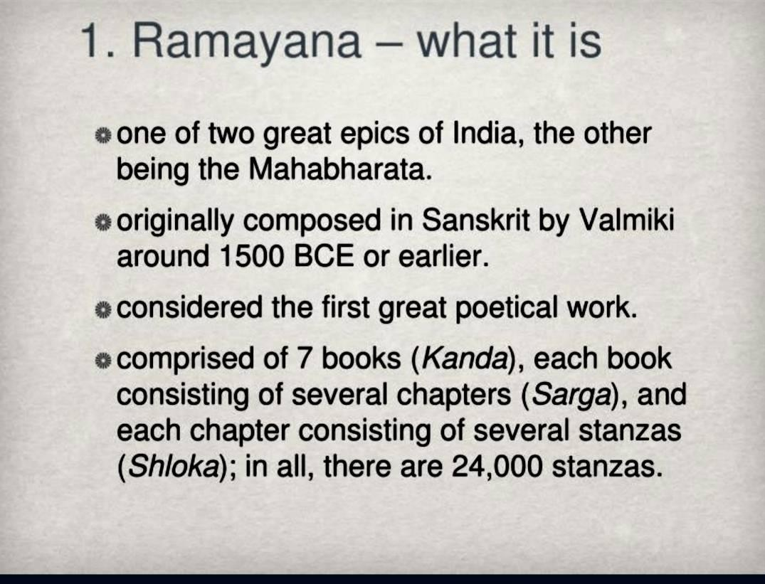

Slide 28
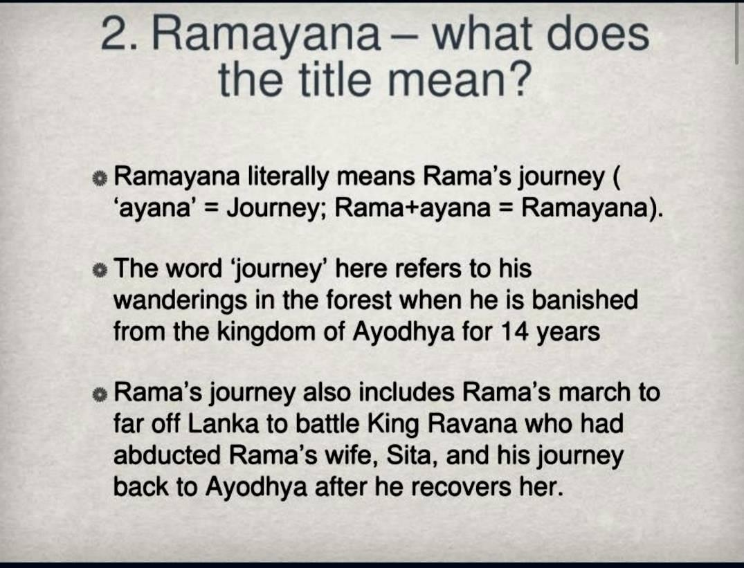

Slide 29
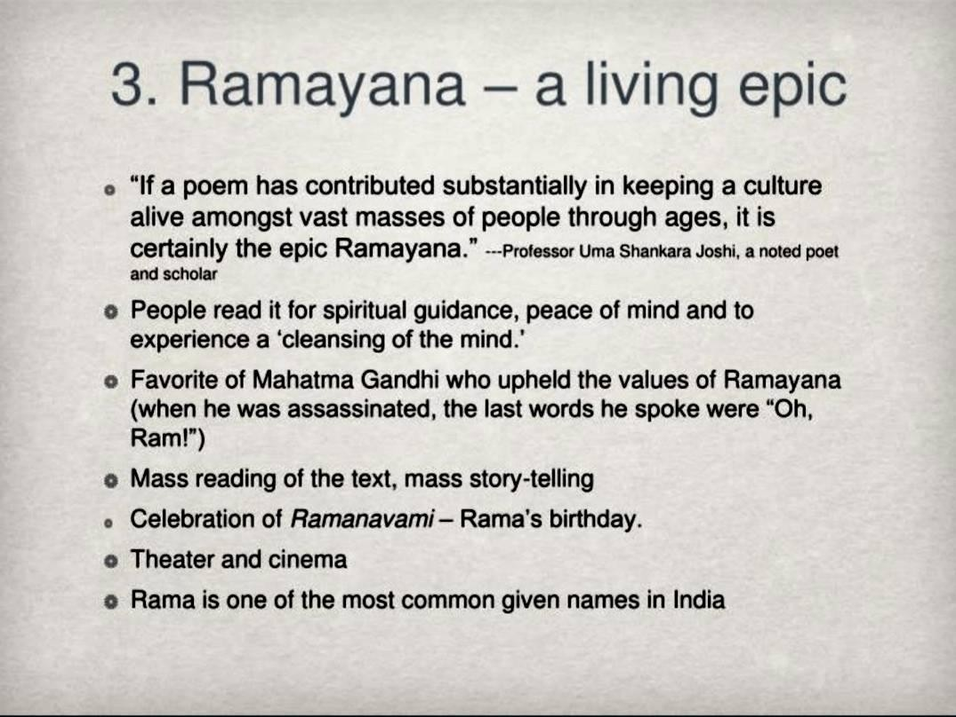

Slide 30
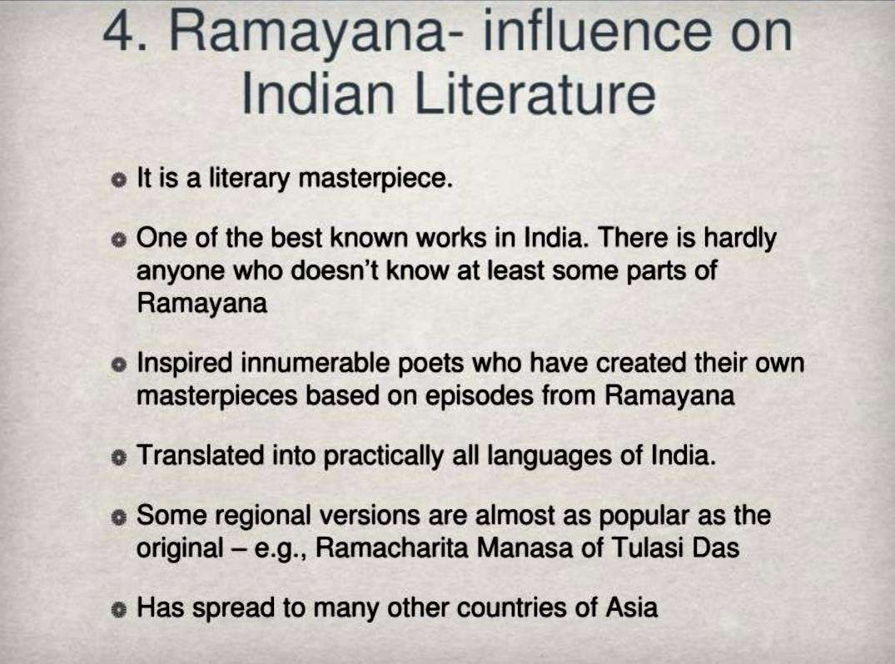

Slide 31
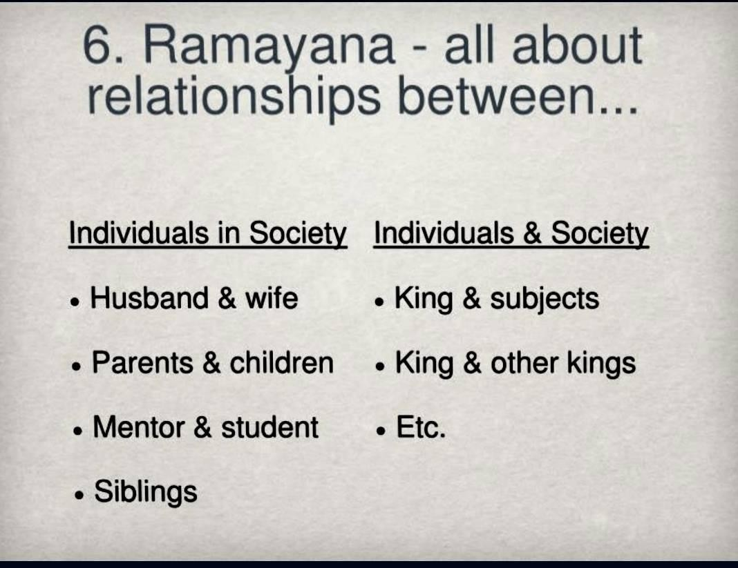

Slide 32
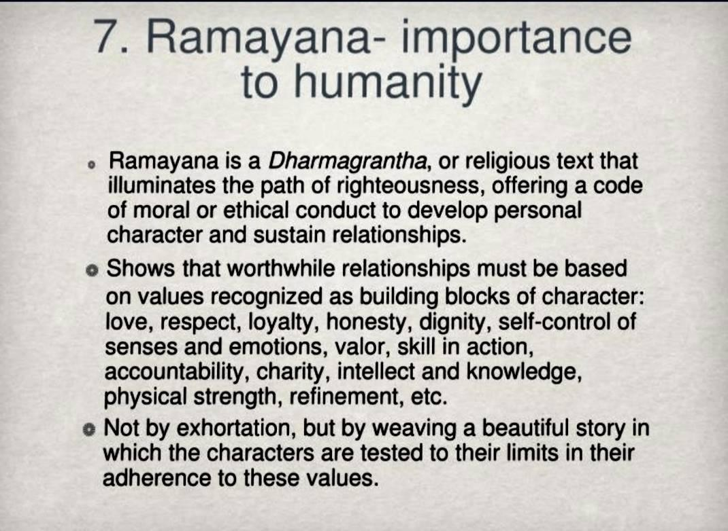

Slide 33
In this epic, through the story of Rama who is projected as the ideal man, we are instructed on how to achieve the four-fold objectives
(Purushartha) of mankind:
Dharma Religion or righteousness
Artha (monetary) Achievements in the worldly sphere
Kama Fulfilling worldly desires
Moksha Liberation from these desires

Slide 34
MAHABHARATA
The Mahabharata has several versions, but the most popular one is penned by Ved Vyas.
It was written in Sanskrit and initially had 8,800 verses. This version was called ‘Jaya’ or the story of ‘victory’. After that several stories were complied and added to this collection.
The number of verses increased to 24,000 and it was renamed as ‘Bharata’ after the earliest Vedic tribes.
The current form consists of 1,00,000 verses and is divided into 10 parvas

Slide 35
The story is based on the conflict between the Kauravas and the Pandavas over the right to claim the throne of Hastinapur. The sutradhar of the story is Lord Krishna. The Mahabharata also consists of an important didactical text of Hindus, i.e., the Bhagwata Gita. This text is like a concise guide to Hindu religions’ philosophical dilemmas and even acts like a guide to mankind on how to live a righteous life. Most of the text is a dialogue between Lord Krishna and the Pandava prince Arjuna about the duties of a man, warrior and prince. He also elaborates on the problem of violence versus non-violence; action versus non-action and in the end about the Dharma. He even makes distinction between various kinds of Dharma and prefers that Arjuna and mankind should follow Nishkama Karma, i.e. to perform one’s duty to the family and the world in a selfless way. Both the above-mentioned epics have been retold in several Indian and foreign languages. It has been dramatised by theatres as well as by television. It is not only because both the stories have a universal appeal, but because they show the right way of human existence and of the necessity of positiveness of human actions.

Slide 36
VEDANGAS, PURANAS & DHARMASUTRAS
The Vedangas (meaning 'limbs of the Vedas'), composed c. 600-200 BC, are supplementary texts for proper understanding and recitation of the Vedas.
A group of Vedanga texts called Dharmasutras deal with dharma and how it should
drive social norms, giving glimpses into the prevailing social practices.
 The Puranas (meaning 'old') deal with world creation, the genealogies of gods and
rishis, and the royal dynasty.

Slide 37
Puranas
These are ancient Indian mythological texts, which consist of the narrative stories about the creation of the universe and illustrate its history till the supposed destruction of the universe.
It contains the stories of the kings, heroes, sages, and demiGods, but it focuses on the divine Hindu trimurti or trinity/ three Gods: Brahma, Vishnu and Mahesh.
There are 18 main Puranas, including the Vishnu, Vayu, Matsya, Bhagvat and Agni Purana
Provide details on the ancient political history, referring to early dynasties like the Nandas, Mauryas and the Satavahanas.
Provides information on the development of Hindu religious practices.

Slide 38
These contain anecdotes about the social, cultural and religious life of post-Vedic India and provide the historians with critical information about the geography, history and the dynastic genealogies.
These Puranas are written in the form of stories, which combine myths, legends and sermons about the deities and this easy form of story-writing made it very popular amongst the masses who did not always understand the complex Vedas
Hence, the Puranas were translated and distributed in various vernacular languages. The Puranas use parables and fables to spread their message:
Parable Short stories that in prose or verse, illustrates a spiritual, moral or religious lesson. It usually features a human character.
Fable Short stories that in prose or verse, illustrates a ‘moral’ through a pithy maxim or clever story. It features animals, inanimate objects, mythical creatures, plants who are given human like qualities.

Slide 39
BUDDHIST LITERATURE
Important sources for the history of Buddhism and its royal patrons like Ashoka.
Uncover the aspects of political, social and economic conditions of the
period.

Slide 40
TRIPITAKAS
3 Pitakas – The Three Baskets/Collections
Written in Pali text
Lays down the tenets and principles of Buddhism.
3 Pitakas:
Sutta Pitaka, containing the sermons of the Buddha
Vinaya Pitaka, which has rules for Buddhist monks and nuns
Abhidhamma Pitaka, which contains a systematic arrangement of the teachings of the
Sutta Pitaka.

Slide 41
 The Jatakas, composed in the 3rd century BC - 2nd century AD, relate stories of the previous births of the Buddha.
 They have also served to give a glimpse of the social history of the period.
 Buddhaghosha, in the 5th century AD, wrote a commentary on the Tipitaka.
 The Sri Lankan Chronicles from the 5th century – the Dipavamsa and the Mahavamsa – deal with the
Buddha's life, the Buddhist councils, emperor Ashoka and the kings of Sri Lanka.

Slide 42
JAIN LITERATURE
 Offers information on the history and doctrines of Jainism, as well as facets of the cultural life of the times.
 The sacred books of the Jains are collectively known as the Siddhanta or Agama, the most
important of which are the twelve Angas.
The early texts were in Prakrit.
These books have been supposed to be compiled around 5th- 6th century AD.
The Jain Puranas (Charitas) are the biographies of the Jain saints (thirthankaras)

Slide 43
THANK YOU !

